Slide 1
Broadband Traffic Prediction
Task:
Develop a model to forecast the broadband traffic of PLDT to help the operation, planning / engineering, and marketing to strategize and capture insights that will drive informed decision and can help optimize network infrastructure, bandwidth allocation, and service quality
Data Gathering
Decision Making
Data
Preprocess and EDA
Present Results
Data Modeling
Evaluating Models and Analysis

Slide 2
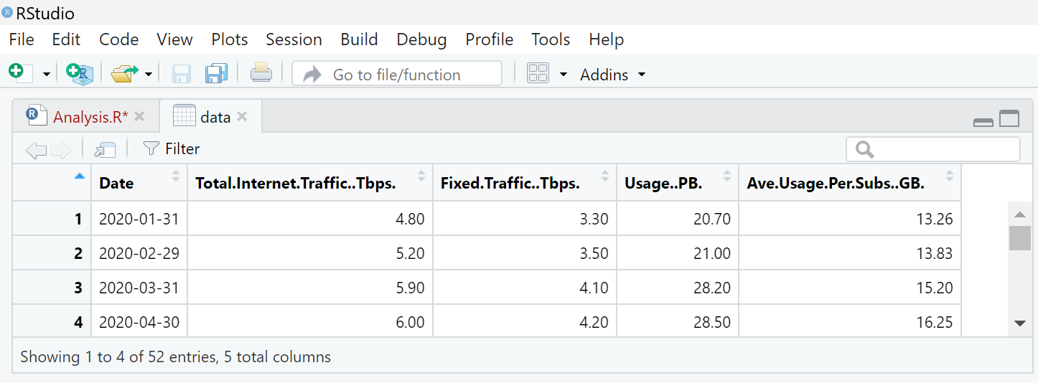
Data Collection Extract from PLDT FSNTP
2020 – 2024
Extracted dataset:
Data Gathering
Decision Making
Data
Preprocess and EDA
[Date]
[Traffic (Tbps)]
[Usage (TB)]
[Average Usage Per Subs (GB)]
Present Results
Data Modeling
Evaluating Models and Analysis

Slide 3
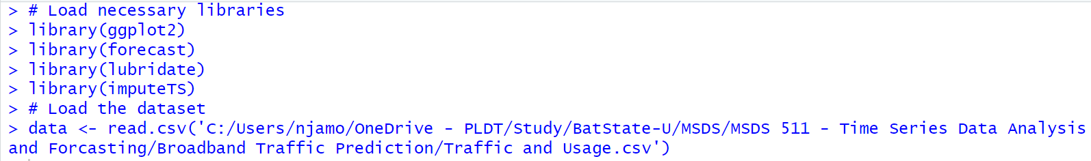
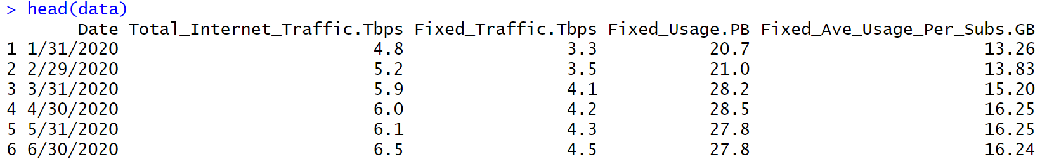
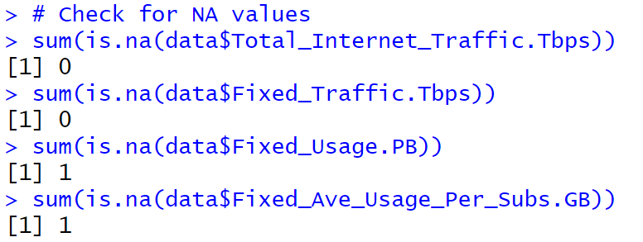
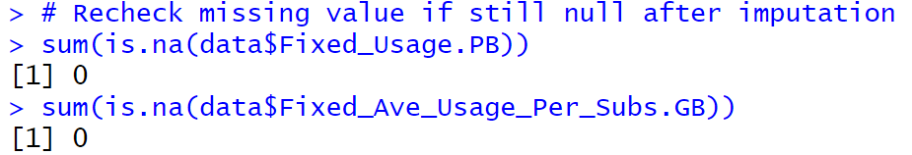
Data Preparation and Analysis [1] ELT : Load and Clean/Transform Dataset
Data Gathering
Decision Making
Data
Preprocess and EDA
Present Results
Data Modeling
Evaluating Models and Analysis

Slide 4
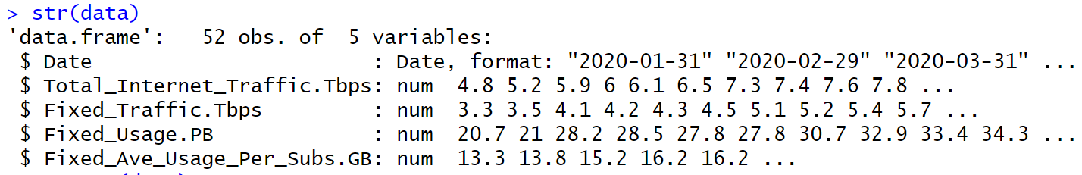
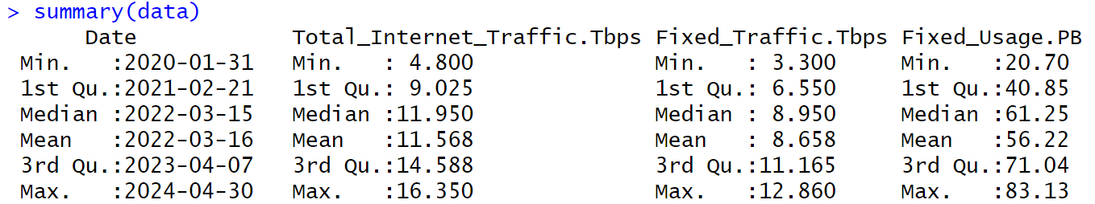
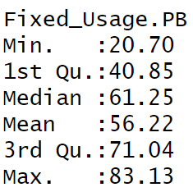
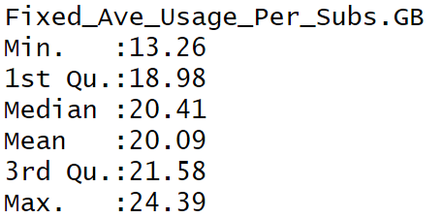
Data Preparation and Analysis [2] EDA : Explore the structure and summary of data
Data Gathering
Decision Making
Data
Preprocess and EDA
Present Results
Data Modeling
Evaluating Models and Analysis

Slide 5
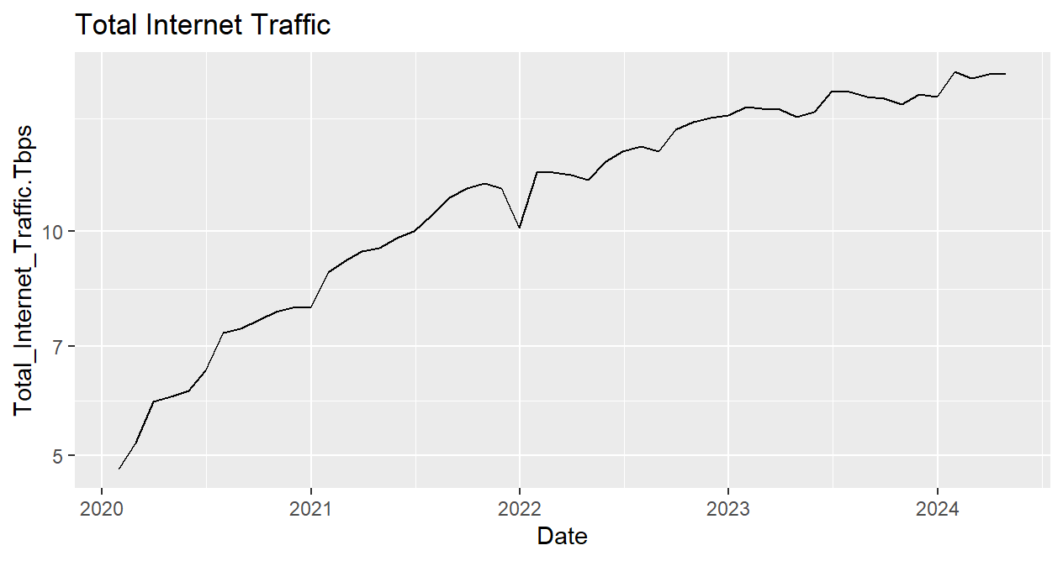
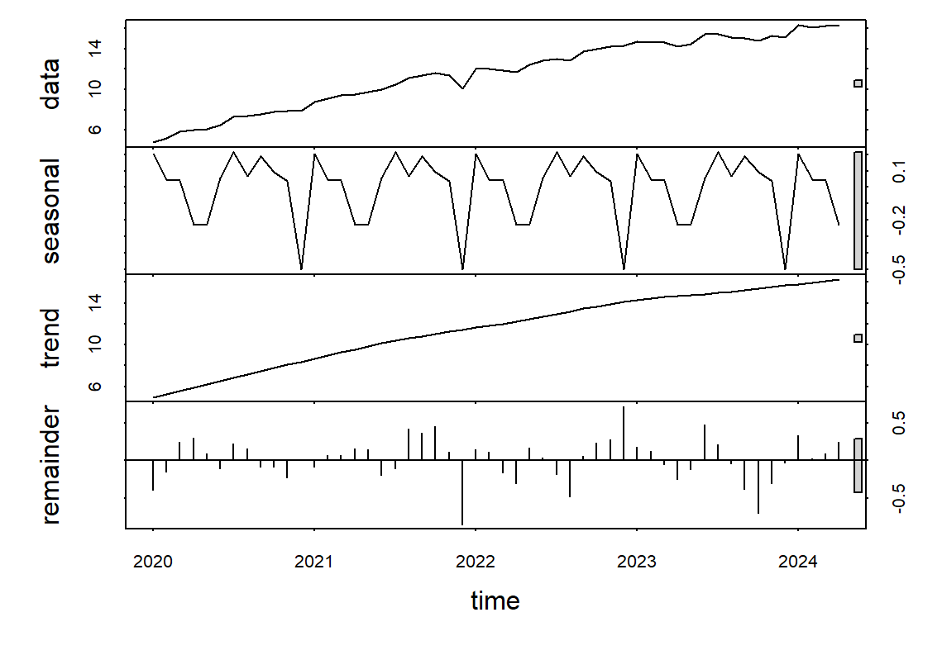

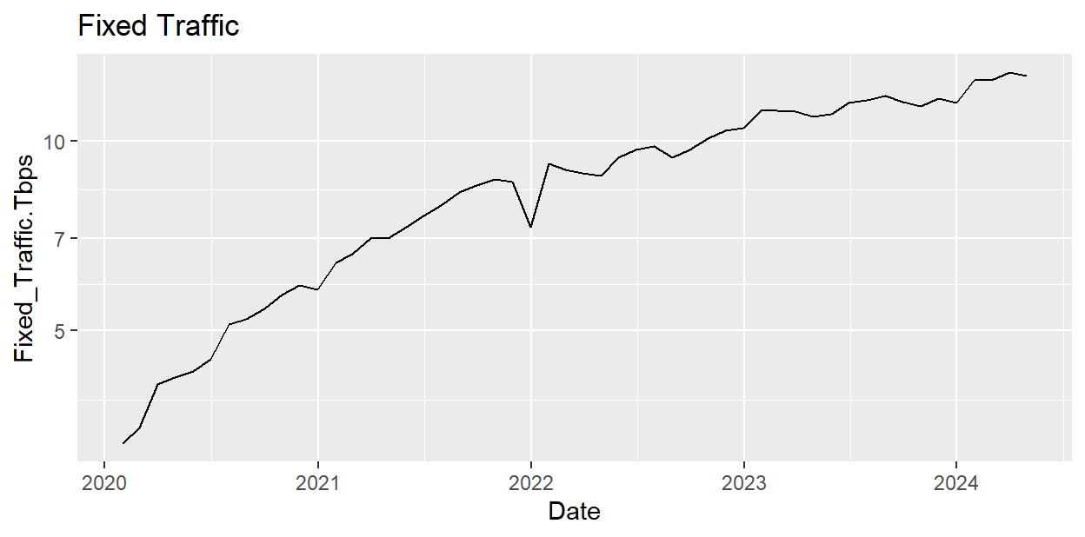
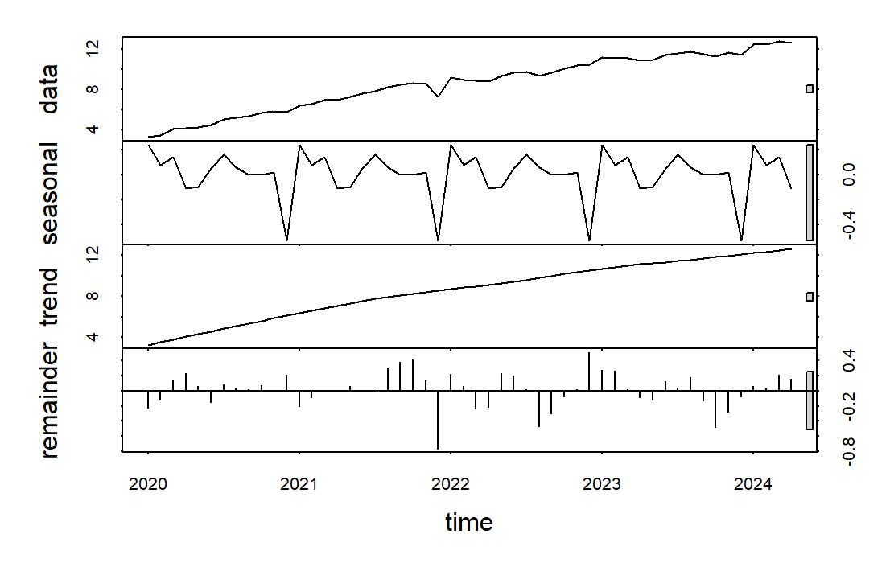

Data Preparation and Analysis [3] EDA : Visualization
Data Gathering
Decision Making
Data
Preprocess and EDA
TYPHOON
ODETTE
(Dec 16 ‘21)
Present Results
Data Modeling
Evaluating Models and Analysis

Slide 6


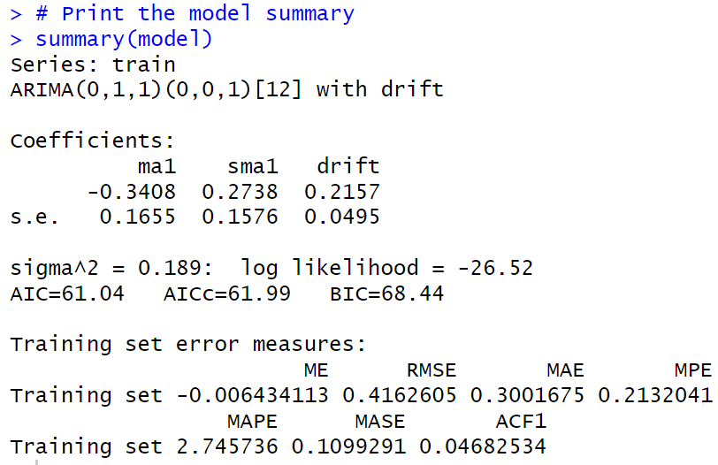
Data Modeling : Auto ARIMA [1] Fitting the model
Data Gathering
Decision Making
Data
Preprocess and EDA
Present Results
Data Modeling
Evaluating Models and Analysis

Slide 7

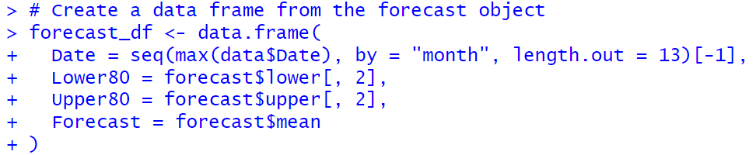
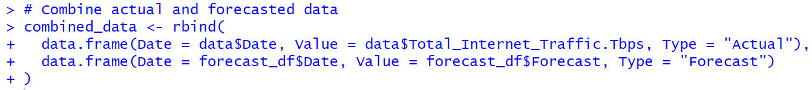
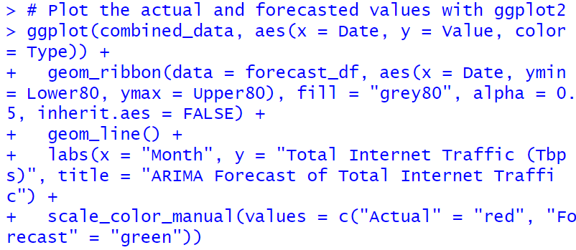
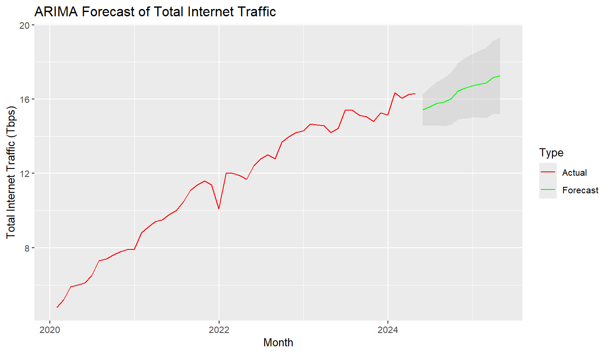
Data Model: Auto ARIMA [2] Forecasting and getting the predicted values
Data Gathering
Decision Making
Data
Preprocess and EDA
Present Results
Data Modeling
Evaluating Models and Analysis

Slide 8
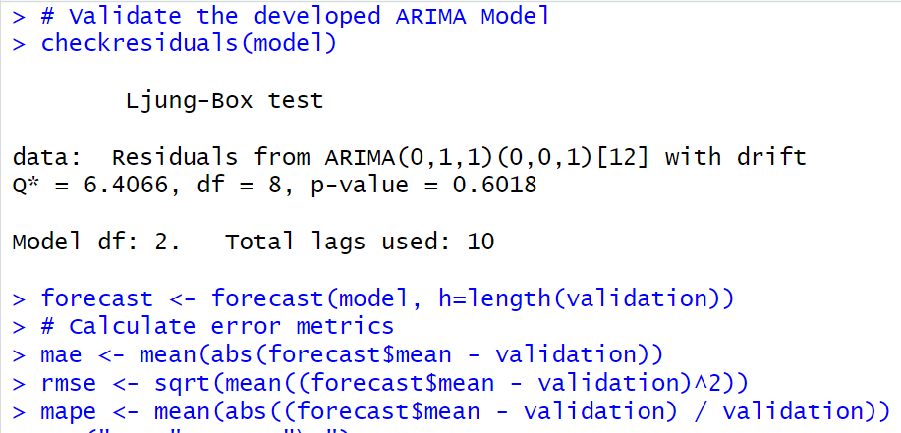
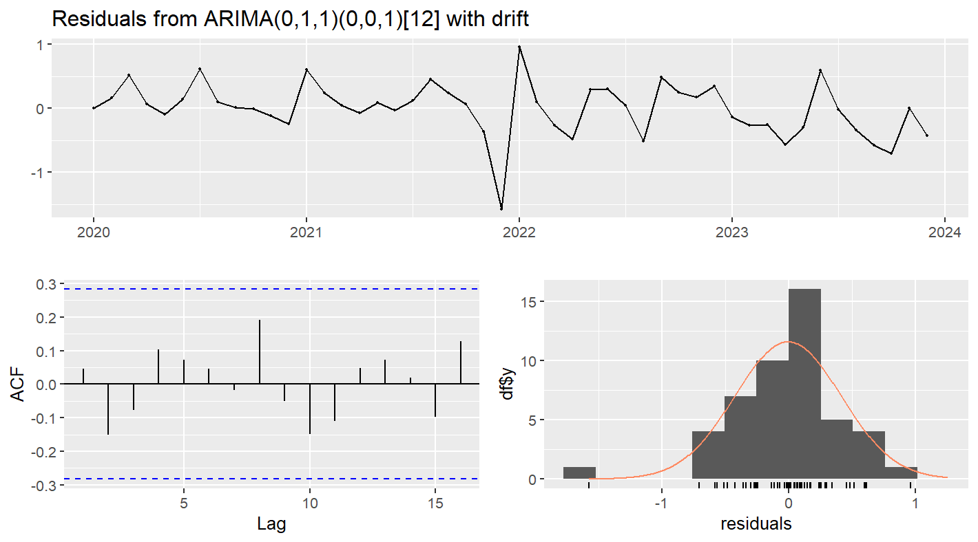
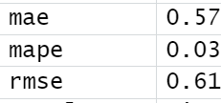
Validation of Auto ARIMA Model
Data Gathering
Decision Making
Data
Preprocess and EDA
Present Results
Data Modeling
Evaluating Models and Analysis

Slide 9
End of presentation
Thank you!
Nicole John Mortel

